Slide 1
Bank Customer Churn
Business Intelligence Case Studies 5
Dimas Baseara Pramudita

Slide 2
Table of contents
01.
02.
03.
About Me
Introduction
Data Process
04.
05.
06.
Insight & Recomendation
Modelling ML
Conclusion

Slide 3
About Me
Data Science Enthusiast @dibimbing and @BinarAcademy | Business Intelligence @dibimbing | Python, SQL, EDA, ETL, Data Governance/Warehouse, Machine Learning, Data Visualization | Improvement For Organization performance Through Data

Slide 4
Formal Education
PPIC
Binus
2017-2020
Manajemen Penerbangan
2021-2023
Manajemen Bisnis

Slide 5
Non-Formal Education
Binar
Dibimbing.id
Dibimbing.id
2022
Data Science
2022-2023
Data Science
2023
Business Intelligence

Slide 6
Introduction
In Business Intelligence Case Studies 5, supervised machine learning will be performed using the logistic regression, decision tree classifier, and random forest classifier methods. The models are aimed at predicting customers who will churn from the bank customer churn dataset.

Slide 7
Our Data
RowNumber—corresponds to the record (row) number and has no effect on the output.
CustomerId—contains random values and has no effect on customer leaving the bank.
Surname—the surname of a customer has no impact on their decision to leave the bank.
CreditScore—can have an effect on customer churn, since a customer with a higher credit score is less likely to leave the bank.
Geography—a customer’s location can affect their decision to leave the bank.
Gender—it’s interesting to explore whether gender plays a role in a customer leaving the bank.
Age—this is certainly relevant, since older customers are less likely to leave their bank than younger ones.
Tenure—refers to the number of years that the customer has been a client of the bank. Normally, older clients are more loyal and less likely to leave a bank.
Balance—also a very good indicator of customer churn, as people with a higher balance in their accounts are less likely to leave the bank compared to those with lower balances.
NumOfProducts—refers to the number of products that a customer has purchased through the bank.
HasCrCard—denotes whether or not a customer has a credit card. This column is also relevant, since people with a credit card are less likely to leave the bank.
IsActiveMember—active customers are less likely to leave the bank.
EstimatedSalary—as with balance, people with lower salaries are more likely to leave the bank compared to those with higher salaries.
Exited—whether or not the customer left the bank.

Slide 8
Data Process
Data Cleaning
Data Preprocessing
Exploratory Data Analysis
Modelling
Import libraries & Load Data

Slide 9

Import Libraries & Load Data
At this stage, we import the Python libraries that will be used and load the data to be processed.”

Slide 10
Data Cleaning
At this stage, the following steps are performed:
Checking for missing values.
Checking for duplicate data.
The data we are processing is free from missing values and duplicate data.

Slide 11
Exploratory Data Analysis
In the Exploratory Data Analysis (EDA) phase, we perform the following tasks:
Statistical Summary: Obtain descriptive statistics to understand the central tendency and spread of data.
Data Visualization: Create plots and charts to visualize the distribution of data, relationships between variables, and potential patterns or trends.
Outlier Detection: We identify and handle outliers that may affect the model's performance.
Identify Correlations: Check for correlations between variables and assess their impact on the target variable.

Slide 12
Data Preprocessing
In the Data Preprocessing stage, we perform the following tasks:
Feature Selection: We select relevant features or perform dimensionality reduction to reduce the number of features while preserving important information.
Handling Outliers(optional): We identify and handle outliers that may adversely affect the model's performance.
Encoding Categorical Variables: We convert categorical variables into numerical representations using techniques like one-hot encoding or label encoding.
Feature Scaling: We scale numerical features to bring them to a similar scale, often using techniques like standardization or normalization.
Handling Imbalanced Data(optional): For imbalanced datasets (unequal class distribution), we apply techniques like oversampling, undersampling, or using class weights to address the imbalance.
Train-Test Split: We split the dataset into training and testing sets to evaluate the model's performance on unseen data.

Slide 13
Machine Learning
Modeling in machine learning is the process of developing and training a model based on data to understand patterns or relationships among features (independent variables) and the target (dependent variable). The primary goal of modeling is to create a model that can make accurate predictions on unseen data. we do the following briefly:
Model Selection
Model Training
Model Evaluation
Model Validation
Hyperparameter Tuning
Model Testing
Model Deployment

Slide 14
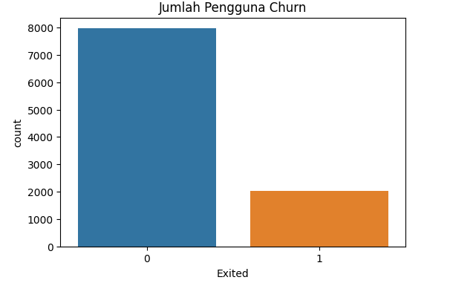

Customer Churn
It can be observed that the number of loyal users is significantly higher compared to churned users.

Slide 15
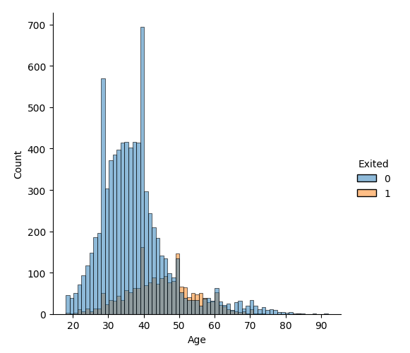
Age of Customer
It appears that churned customers are mostly elderly individuals, indicating that the product may not be suitable for them. Therefore, the recommendation is to customize our product to better suit their needs.

Slide 16
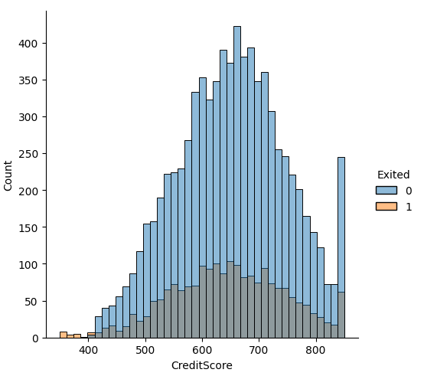
Credit Score of Customer
It appears that churned users have low credit scores. This may be based on the company's lending policy, or a recommendation that can be implemented is to the company might consider creating a special program for them.

Slide 17
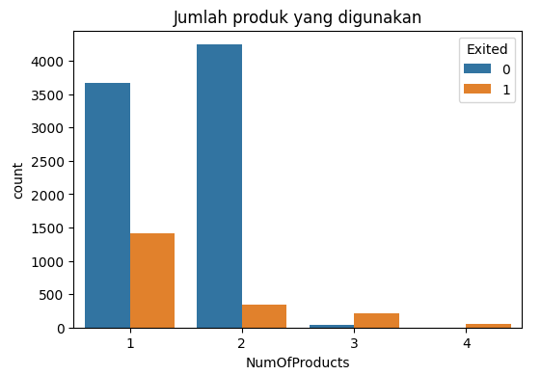
Number of products used by each customer
It appears that there is a possibility of dissatisfaction among customers. There seems to be a likelihood of churn among customers who use only one of our products, and the likelihood of churn increases as they use more of our products. Therefore, a recommendation that can be implemented is to offer bundled product packages and optimize the products offered to improve customer satisfaction.

Slide 18
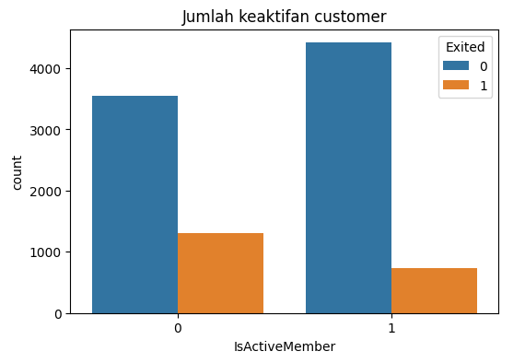
Active Customer
It appears that inactive or infrequent customers are more likely to churn. Therefore, a recommendation that can be implemented is to provide ease of access and convenience during their shopping experience, along with attractive promotions to entice them to stay.

Slide 19
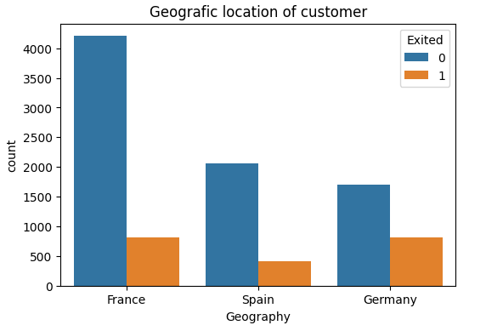
Geografic location of customer
It is evident that many potential churned customers are from Germany. Therefore, a recommendation that can be implemented is to investigate the reasons behind this trend, make product adjustments, and provide attractive offers compared to competitors.

Slide 20
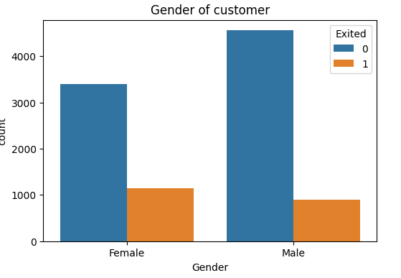
Gender Customer
It is evident that the likelihood of churn among female customers is higher than among male customers. Therefore, a recommendation that can be implemented is to make product adjustments based on their gender.

Slide 21

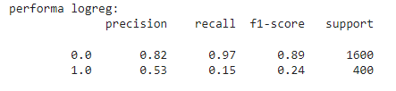
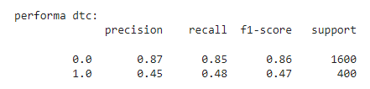
Machine Learning
The machine learning model used are:
Logistic Regression
Decision Tree Classifier
Random Forest Classifier
Note :
The score observed is the recall score. This is because in the case of Churn, the main focus is on the model's ability to correctly identify potential churned customers or those who are likely to stop using the services.
This machine learning modeling was done without imbalance data handling. The best model is “dtc”, but its score is still relatively low. So,we will perform machine learning with imbalance data handling.

Slide 22
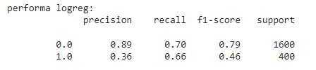
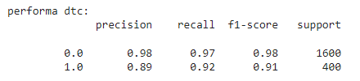
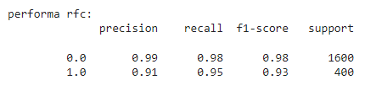
Machine Learning with imbalance data handling
So, the best model is random forest classifier with 95%. Next, we need model validation.

Slide 23
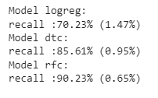
Model Validation using Kfold
What is Kfold ? K-Fold Cross-Validation (K-Fold CV) is a resampling technique used in machine learning to assess the performance of a model and to reduce the risk of overfitting. In K-Fold CV, the original dataset is divided into K subsets, or "folds," of approximately equal size. In this case, original dataset divided into 10 folds.
Once again, the best model machine learning is random forest classifier.

Slide 24
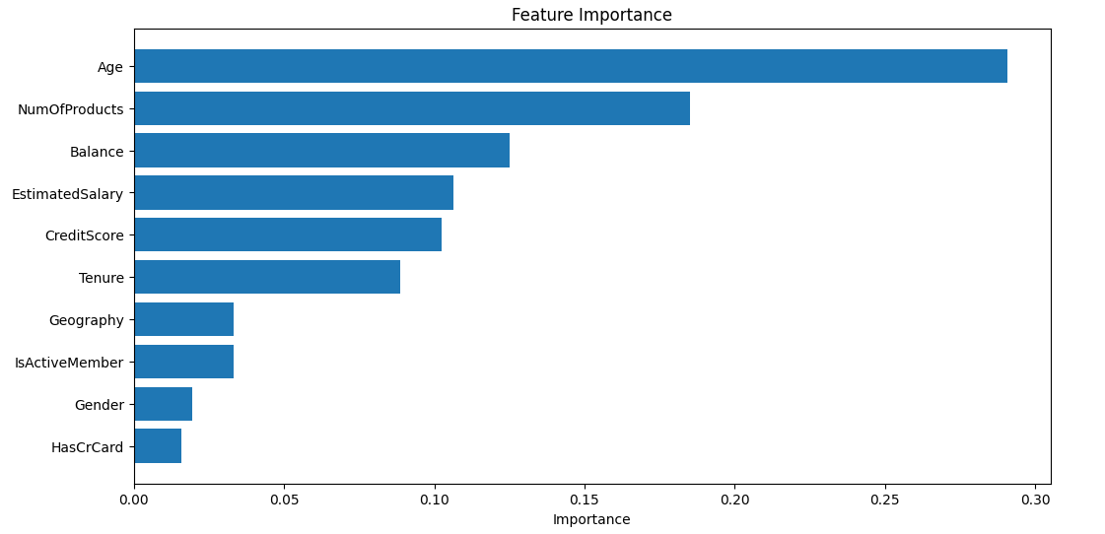
Features Importance
The following are the influential features in the Random Forest machine learning modeling.

Slide 25
Conclusion
The banking industry is a competitive market; therefore, a strategic plan is essential. By effectively processing customer data and understanding customer behavior patterns from the data, valuable business insights can be generated to identify shortcomings in our products in the market. This enables us to make necessary adjustments and improvements to attract customers. Additionally, by processing the data, we can create machine learning models like before, where our model can predict 90% of customers who are likely to churn. This allows us to take preventive measures to retain and keep those customers with us.

Slide 26


Thanks!
For the notebook and others project?
Please, check this link below
Please keep this slide for attribution

